Slide 1
Abstraction and Hierarchy
Abstraction and Hierarchy
BSU CS4MS - 4/9/19
http://www.cs.bsu.edu/cs4ms/docs/AbstractionHierarchySlides.pptx

Slide 2
What is Abstraction?
Abstraction is one of the essential parts of Computer Science. It includes filtering out characteristics that you do not need so you can focus on those that you do need.
It is the filtering out of specific details.
After filtering out unnecessary details and characteristic, you can create a model of what you are trying to solve.

Slide 3
Example of Irrelevant Characteristics
Below is a list of characteristics of a cat. We want to remove unneeded specific characteristics to build a more universal model that can be used to categorize all cats. Notice: not all specific characteristics are required to be able to identify a cat.
Specific Characteristics
Brown Fur
Long Fur
Four Legs
Tail
Ears
Two Eyes
Likes Fish
Meows
Whiskers
Fur
Remove Specific Characteristics
Brown Fur
Long Fur
Four Legs
Tail
Ears
Two Eyes
Likes Fish
Meows
Whiskers
Fur
Relevant Characteristics
Four Legs
Tail
Ears
Two Eyes
Likes Fish
Meows
Whiskers
Fur

Slide 4


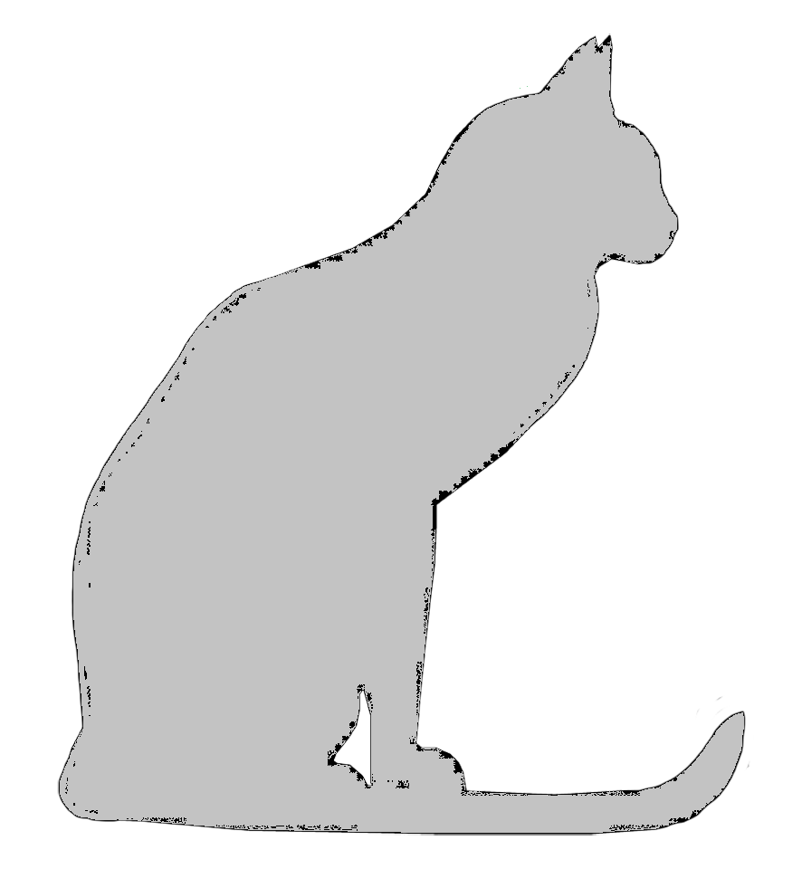
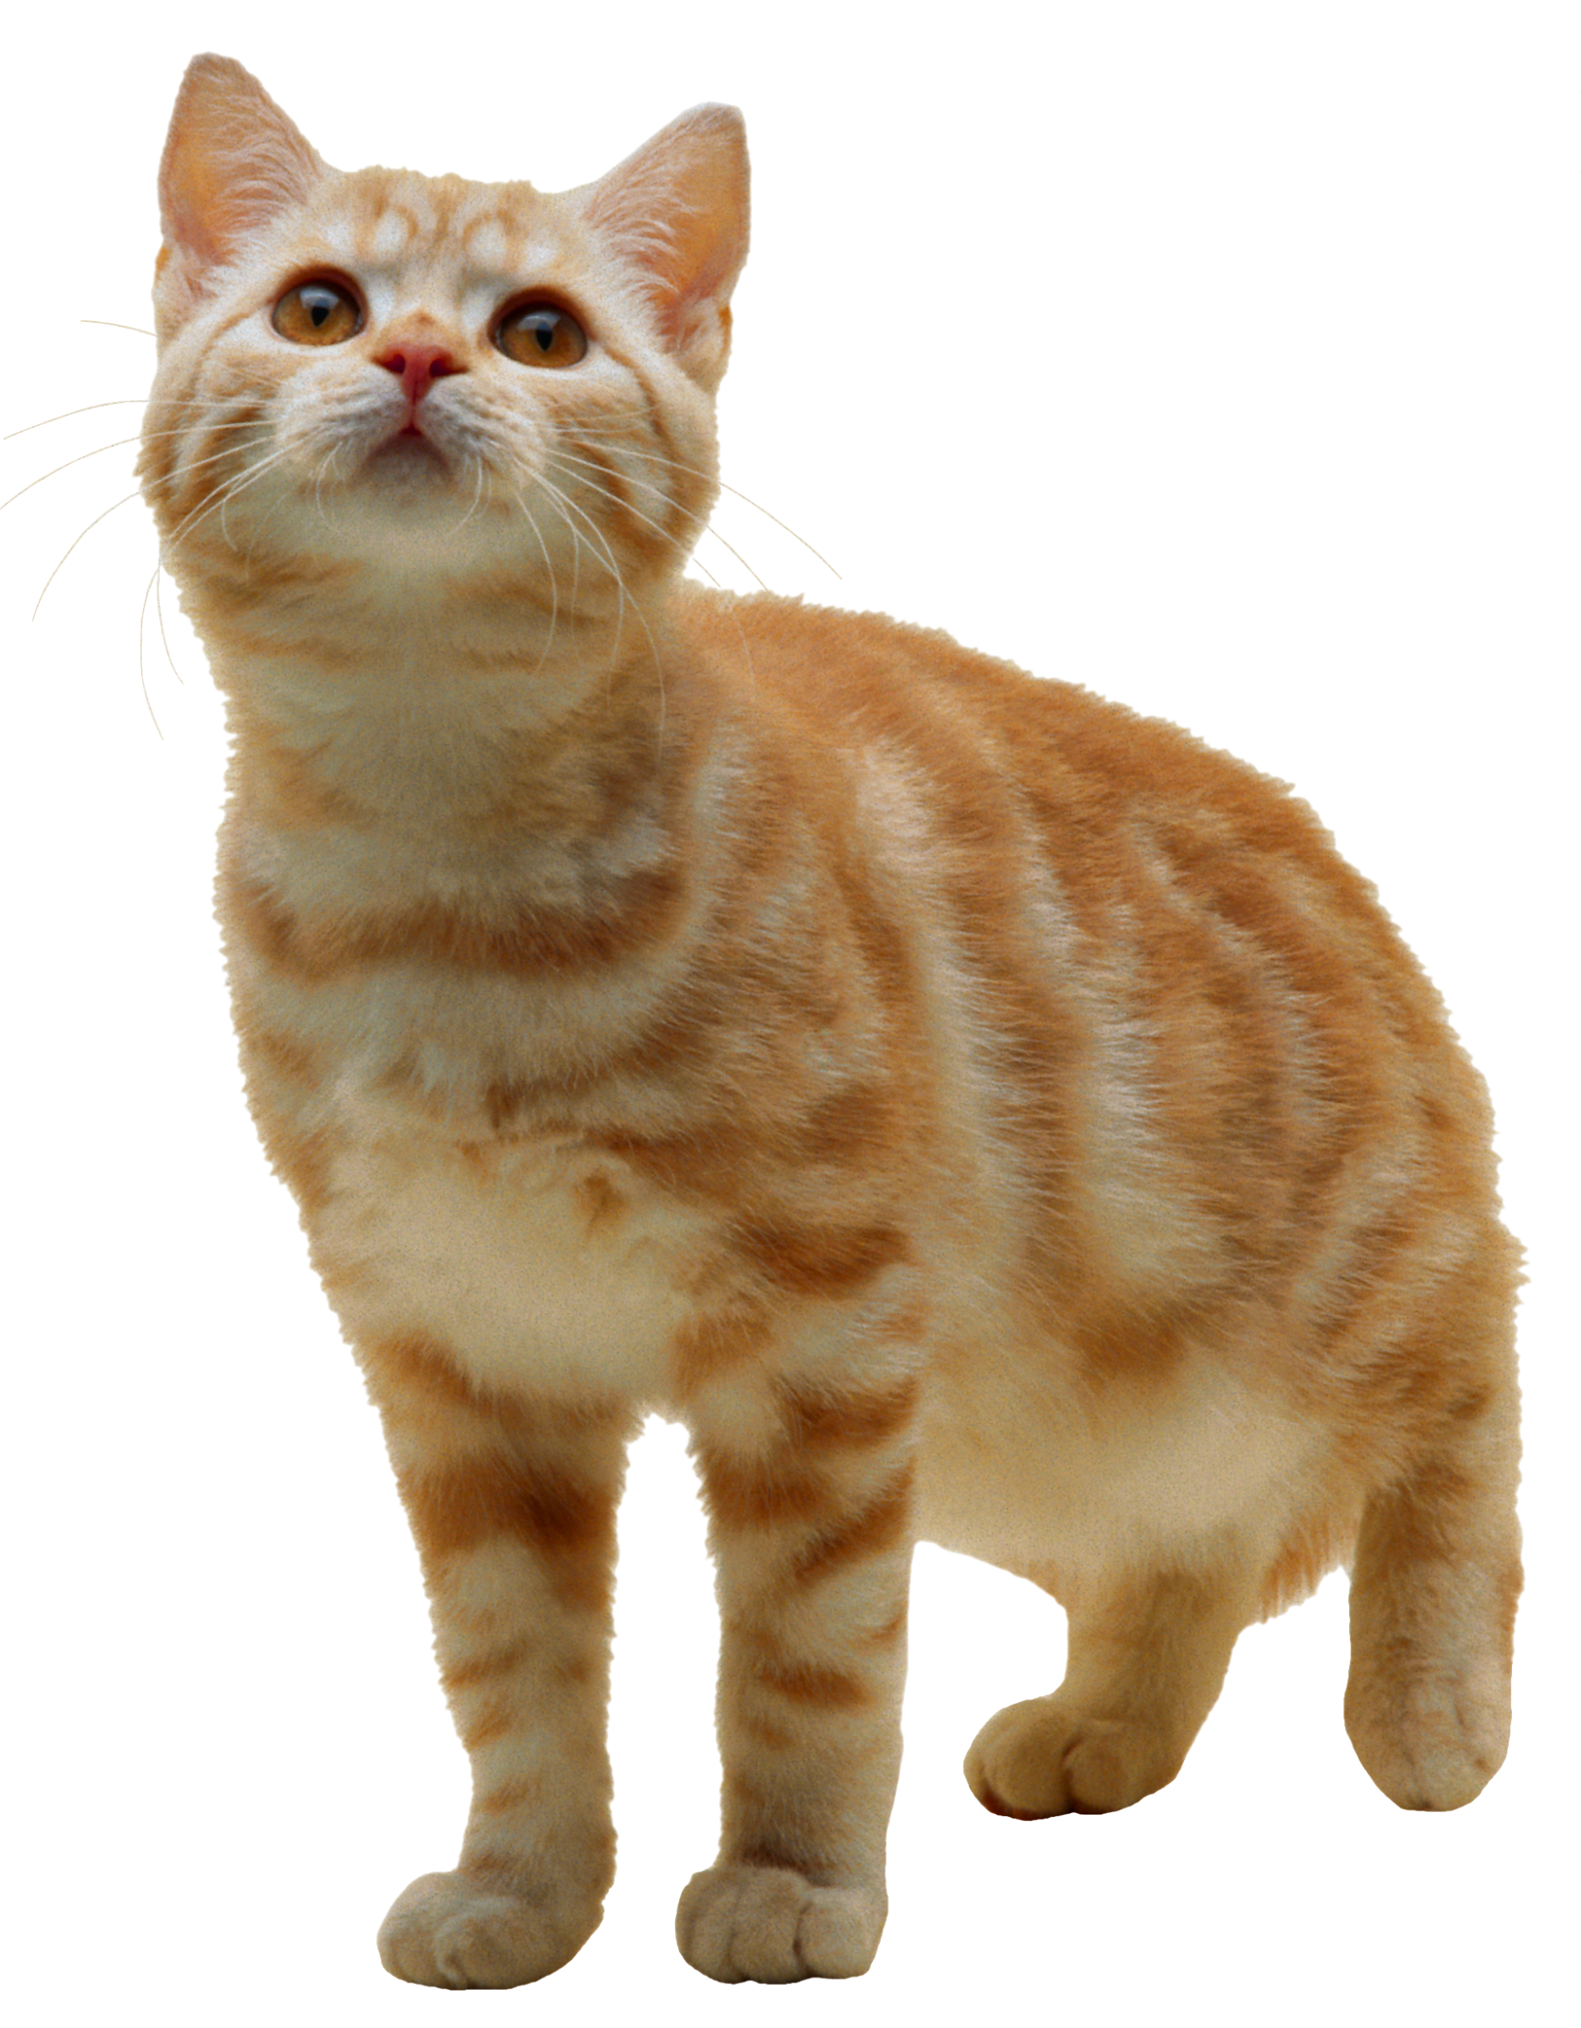
Examples
Created from the Specific Characteristics
Created from the Relevant Characteristics Note: Building from the model based on Relevant Characteristics, we can still tell that the model is a cat.
Meow

Slide 5
Using Abstraction For Tasks
Now that we know about filtering out unneeded information, let’s take a look at using this with tasks.
If you had a list of instructions for feeding the cat, it might look something like this:
Feed Cat:
Make sure cat food bowl is empty
Open cabinet
Get out cat food
Fill cat food bowl
Put cat food away
Close cabinet

Slide 6
Using Abstraction For Tasks
Now, we need to feed the dog as well, so we need a list of steps on how to feed the dog. It might look like this:
Feed Dog:
Make sure dog food bowl is empty
Open cabinet
Get out dog food
Fill dog food bowl
Put dog food away
Close cabinet

Slide 7
Using Abstraction For Tasks
Now let’s take a look at our two tasks.
Feed Cat:
Feed Dog:
Make sure cat food bowl is empty
Open cabinet
Get out cat food
Fill cat food bowl
Put cat food away
Close cabinet
Make sure dog food bowl is empty
Open cabinet
Get out dog food
Fill dog food bowl
Put dog food away
Close cabinet
They look very similar, don’t they? We should try to abstract out the Specific Details to create a generic model for feeding pets.

Slide 8
Using Abstraction For Tasks
Let’s identify all of the things that are different between the tasks. Usually, those are the specific details that we want to abstract away. Then, we can replace the Specific, with the Relevant and generic terms.
Feed Cat:
Feed Dog:
Feed Pet:
Make sure cat food bowl is empty
Open cabinet
Get out cat food
Fill cat food bowl
Put cat food away
Close cabinet
Make sure dog food bowl is empty
Open cabinet
Get out dog food
Fill dog food bowl
Put dog food away
Close cabinet
Make sure pet food bowl is empty
Open cabinet
Get out pet food
Fill pet food bowl
Put pet food away
Close cabinet

Slide 9
Using Abstraction For Tasks
Now that we got rid of the Specific Characteristics, we can use our new task to show how to feed any of the household animals, instead of needing a task for each one!
Recap: Abstraction is getting rid of Specific Characteristics while keeping the Relevant Characteristics needed for completing a task. We do this so we can use the same set of instructions to complete many different tasks, instead of having to create a new set of instructions for every task.

